Slide 1
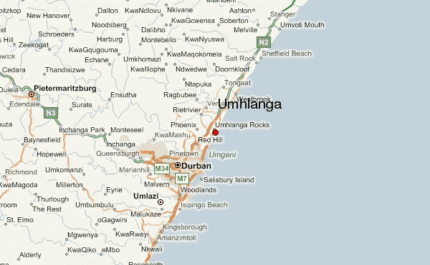
COSC 4368 News Feb. 1, 2021
Today’s Lecture Background: Whalebone Pier, Umhlanga, South Africa (see above)
If you did not succeed to register for KRITIK yet: Go to Kritik Webpage and then use local chat…
ProblemSet1 should be available on the course website between approx. Feb. 3…
This week:
Informed Search (Search 3)
Local Search and Exploration (Search 3)
Randomized Hill Climbing (will not cover other slides in Search 4)
Constraint Satisfaction Problems (use textbook slides)
Online Credit Groups for last names starting A…K will be set up by Feb. 4…
Textbook 4th Edition: http://aima.cs.berkeley.edu/

Slide 2
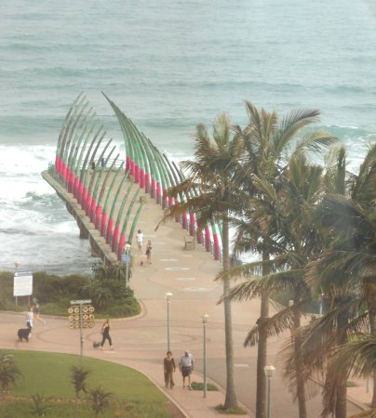
Informed Search and Exploration
Search Strategies
Heuristic Functions
Local Search Algorithms
Whalebone Pier

Slide 3
Introduction
Informed search strategies:
Use problem specific knowledge
Can find solutions more efficiently than
search strategies that do not use domain
specific knowledge.

Slide 4
Greedy Best-First Search
Expand node with lowest evaluation
function f(n)
Function f(n) estimates the distance to
the goal.
Simplest case: f(n) = h(n) estimates cost of
cheapest path from node n to the goal.
** HEURISTIC FUNCTION **

Slide 5
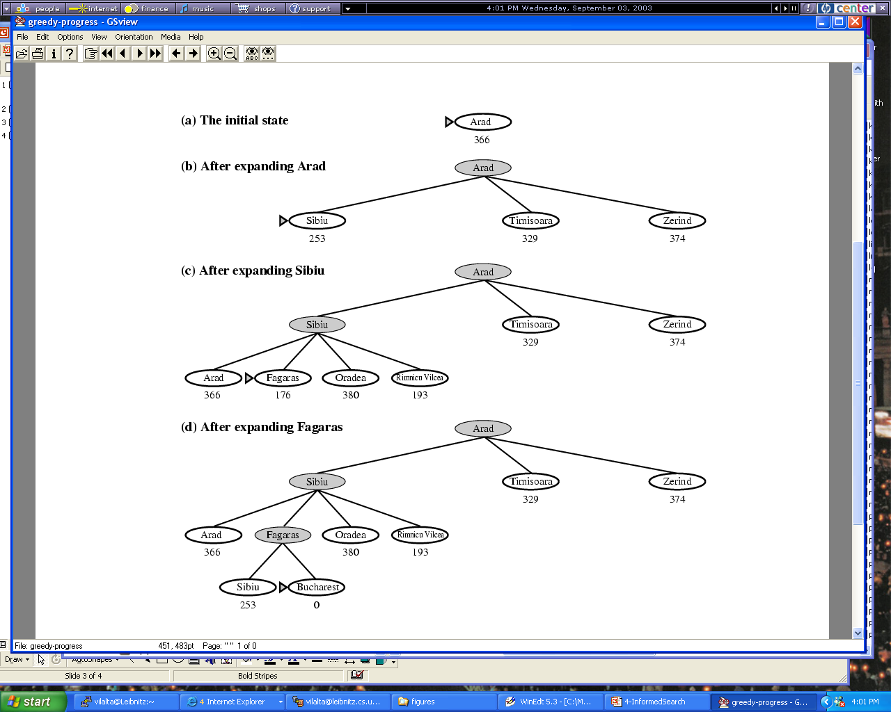
Figure 4.2

Slide 6
Best-First Search
Resembles depth-first search
Follows the most promising path
Non-optimal
Incomplete

Slide 7
Best First Search
Inputs: state evaluation function f, initial state, goal state test
f can be any state evaluation function
Output: fail or path from goal state to initial state
Data Structures
Open: contains states that have not been expanded
Close: contains already visited states
Expands the best state according to f until either Open is empty or a goal state have been found or the algorithm runs out of time or storage.
Many versions and variations of Best First Search exist with A* being the most popular one---Greedy best first search is another specific version.

Slide 8
Best-First-Search Pseudo-Code
Best-First-Search(Start, Goal_test, f)
insert(Start,Open);
repeat forever {
if (empty(Open)) then return ‘fail’;
remove ‘best’ Node from Open using f;
insert(Node,Close)
if (Goal_test(Node)) then return Path Node to Initial State;
for each Child of Node do {
if (Child not in Close) then {
Child.previous := Node;
Insert(Child,Open ) }}
}

Slide 9
A* Search
Uses Graph-Search with Evaluation Function:
f(n) = g(n) + h(n)
Estimated cost of
cheapest path from
node n to goal
Path cost from root
to node n

Slide 10
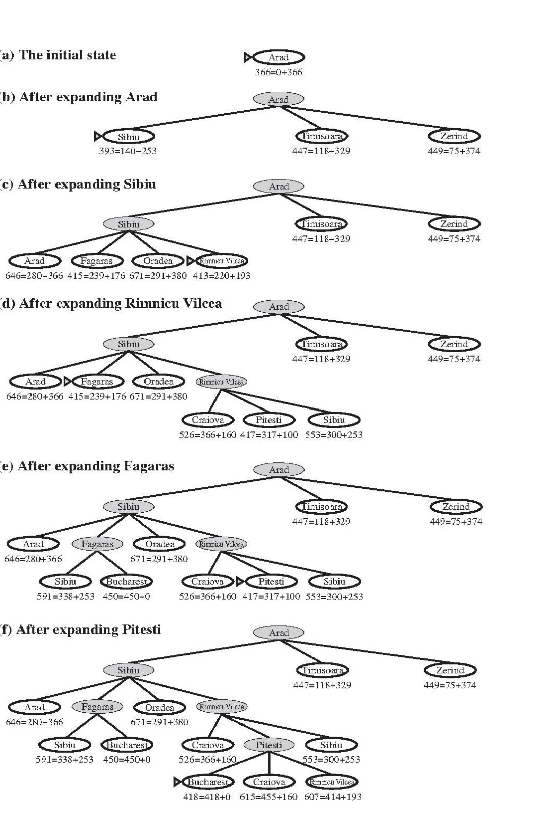
Example Run A* (Figure 3.24)
A* demo:
https://en.wikipedia.org/wiki/A*_search_algorithm

Slide 11
A* Search; optimal
Optimal.
Optimal if admissible heuristic
admissible: Never overestimates the cost to reach a goal from a given state.
Assumes positive cost in the search graph

Slide 12
A* Search; optimal
Assume optimal solution cost is C*
Suboptimal node G2 appears on the fringe:
f(G2) = g(G2) + h(G2) > C*
Assume node n is an optimal path:
f(n) = g(n) + h(n) <= C*
Therefore f(n) ≤ C* < f(G2)
Nodes on the optimal path will
always be expanded before G2

Slide 13
A* Search; complete
A* is complete.
A* builds search “bands” of increasing f(n)
At all points f(n) < C*
Eventually we reach the “goal contour”
Optimally efficient
Most times exponential growth occurs

Slide 14
Contours of equal f-cost
400
420

Slide 15
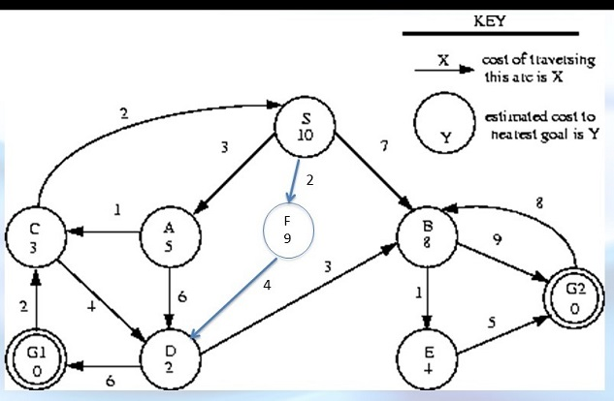
State Space Graph for A* (PS1 2019)
H
2
2
1

Slide 16
Data Structures of Expansion Search
Search Graph:= discussed earlier
Open-list:= set of states to be expanded
Close-list:= set of states that have already been expanded; many implementation do not use close-list (e.g. the version of expansion search in our textbook) → potential overhead through looping but saves a lot of storage

Slide 17
Problem: Expansion Search Algorithms Frequently Run Out of Space
Possible Solutions:
Restrict the search space; e.g. introduce a depth bound
Limit the number of states in the open list
Local Beam Search (just put k successors into the open list)
Use a maximal number of elements for the open-list and discard states whose f-value is the highest.
SMA* and MA* combine the previous idea and other ideas
RBFS (mimics depth-first search, but backtracks if the current path is not promising and a better path exist; advantage: limited size of open list, disadvantage: excessive node regeneration)
IDA* (iterative deepening, cutoff value is the smallest f-cost of any node that is greater than the cutoff of the previous iteration)

Slide 18
Local beam search
Keep track of best k states
Generate all successors of these k states
If goal is reached stop.
If not, select the best k successors
and repeat.

Slide 19
Informed Search and Exploration
Search Strategies
Heuristic Functions
Local Search Algorithms

Slide 20
8-Puzzle
Common candidates:
F1: Number of misplaced tiles
F2: Manhattan distance from each tile to its
goal position.

Slide 21
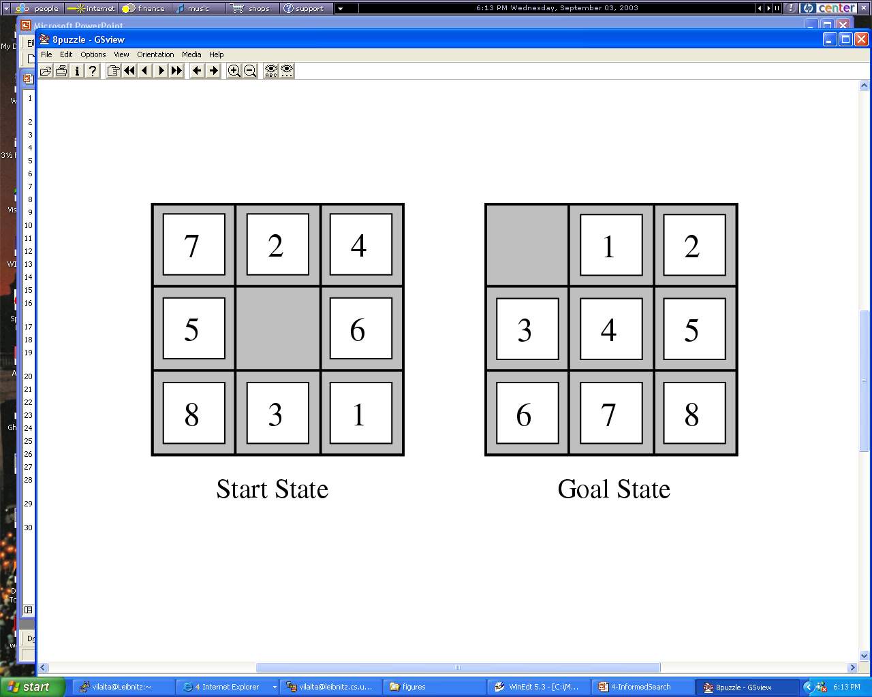
Figure

Slide 22
How to Obtain Heuristics?
Ask the domain expert (if there is one)
Solve example problems and generalize your experience on which operators are helpful in which situation (particularly important for state space search)
Try to develop sophisticated evaluation functions that measure the closeness of a state to a goal state (particularly important for state space search)
Run your search algorithm with different parameter settings trying to determine which parameter settings of the chosen search algorithm are “good” to solve a particular class of problems.
Write a program that selects “good parameter” settings based on problem characteristics (frequently very difficult) relying on machine learning
Notes:
The last technology I like to introduce in today’s presentation are shared ontologies. Shared ontologies are important to standardize communication, and for gathering information from different information sources. Ontologies play an important role for agent-based systems.
Ontologies basically describe...

Slide 23
More on A* and Similar Algorithms
➔ Search7.pptx to be discussed later
Notes:
The last technology I like to introduce in today’s presentation are shared ontologies. Shared ontologies are important to standardize communication, and for gathering information from different information sources. Ontologies play an important role for agent-based systems.
Ontologies basically describe...

Slide 24

Informed Search and Exploration
Search Strategies
Heuristic Functions
Local Search Algorithms

Slide 25
Local Search Algorithms
If the path does not matter we can deal
with local search.
They use a single current state
Move only to neighbors of that state
Advantages:
Use very little memory
Often find reasonable solutions

Slide 26
Local Search Algorithms
It helps to see a state space landscape
Find global maximum or minimum
Complete search: Always finds a goal
Optimal search: Finds global maximum
or minimum.

Slide 27
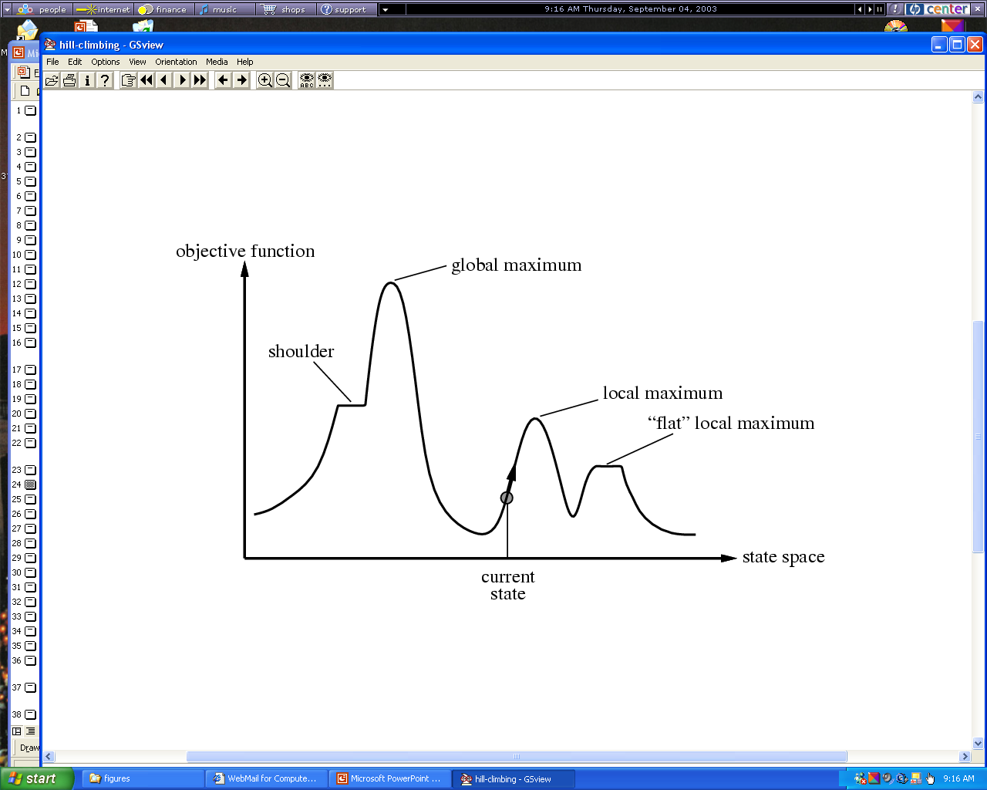
Figure 4.10

Slide 28
Hill Climbing
https://everipedia.org/wiki/lang_en/Hill_climbing/
https://en.wikipedia.org/wiki/Hill_climbing
Moves in the direction of increasing value.
Terminates when it reaches a “peak”
Is often run multiple times with different initial
values
Only moves forward and neither backtrack nor
explore multiple paths in parallel
Does not look beyond immediate neighbors
(variant: use definition of a neighborhood
➔ later).

Slide 29
Hill Climbing
Can get stuck for some reasons:
Local maxima
Ridges
Plateau
Variants: stochastic hill climbing➔more details later
random uphill move
generate successors randomly
run hill climbing multiple times using different
initial states (random restart)

Slide 30
Simulated Annealing
Instead of picking the best move, pick
randomly
If improvement is observed, take the step
Otherwise accept the move with some
probability
Probability decreases with “badness” of step
And also decreases as the temperature goes
down

Slide 31
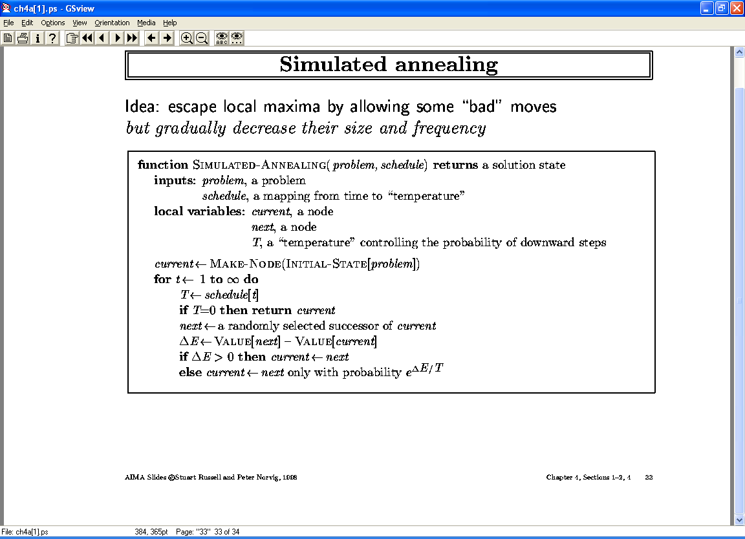

Slide 32
Example of a Schedule Simulated Annealling
T=f(t)= (2000-t)/2000 --- runs for 2000 iterations
Assume ΔE=-1; then we obtain
t=0 → downward move will be accepted with probability e⁻¹
t=1000 → downward move will be accepted with probability e⁻²
t=1500 → downward move will be accepted with probability e⁻⁴
t=1999 → downward move will be accepted with probability e⁻²⁰⁰⁰
Remark: if ΔE=-2 downward moves are less likely to be accepted than when ΔE=-1 (e.g. for t=1000 a downward move would be accepted with probability e⁻⁴⁾

Slide 33
